Slide 1
Precise Analysis
BY: TEAM NOOBCODER

Slide 2
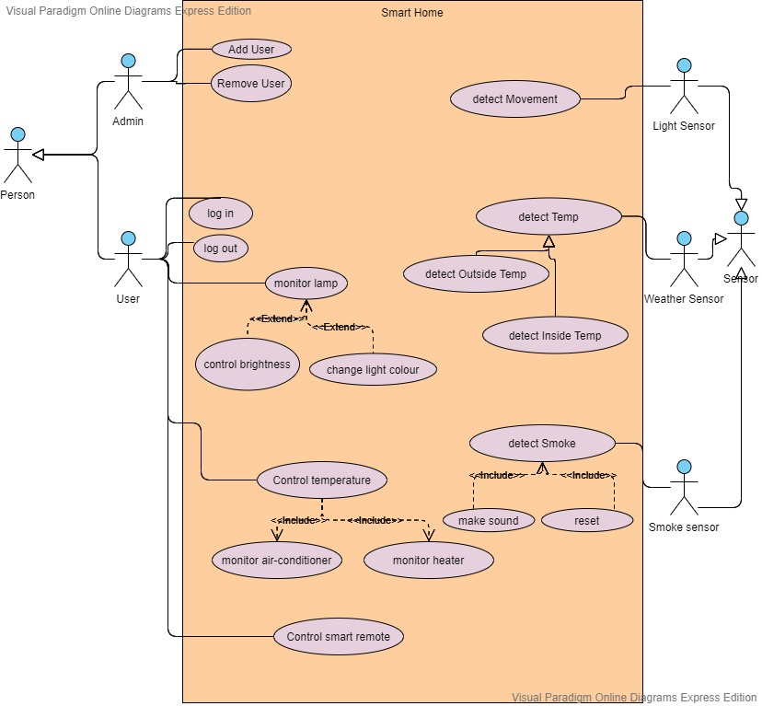
USE CASE DIAGRAM

Slide 3
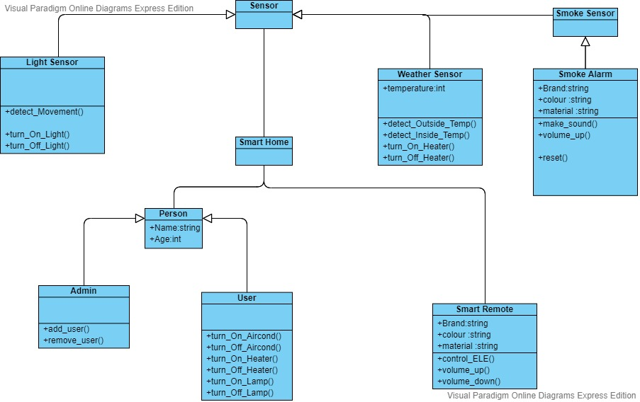
Class Diagram

Slide 4
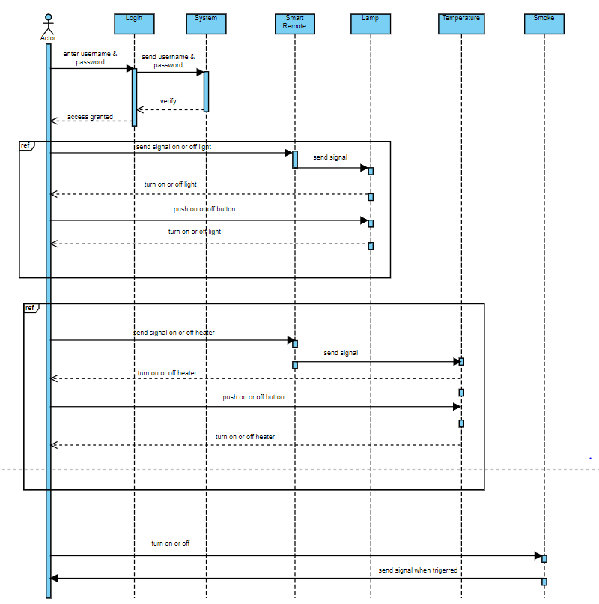
SEQEUNCE DIAGRAM FOR HOME APPLIANCES

Slide 5
THANK YOU

